Slide 1
CS4101 Introduction to Embedded Systems Lab 2: Timer and Clock
Prof. Chung-Ta King
Department of Computer Science
National Tsing Hua University, Taiwan

Slide 2
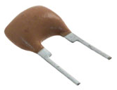
Introduction
In our previous lab, it is difficult to precisely set the timings of the events, e.g. flash frequency of the LEDs, duration of button down, etc.
In this lab, we will learn how to control the timings of events using the timer and clock systems of MSP430
Set time to control when events happen, e.g. flash frequency of LEDs
Measure intervals of events, e.g. duration of button down
Clock
Timer

Slide 3
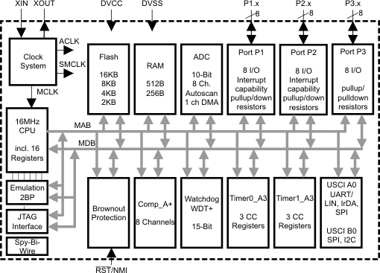
Interior of MSP430G2553
Lab 1
Clock system
IO
X
Not available on 20-pin device
Timer system

Slide 4
Sample Code for Output: Blinking Red LED
#include <msp430.h> int main(void) { WDTCTL = WDTPW | WDTHOLD; // Stop watchdog timer P1DIR |= 0x01; // Set P1.0 as output for(;;) { volatile unsigned int i; // prevent optimization P1OUT ^= 0x01; // Toggle P1.0 using XOR i = 20000; // SW Delay do i--; while(i != 0); } return 0; }

Slide 5
Lab 2
Basic 1: Flash the LEDs with Timer0_A3 (30%)
Modify Sample Code for Output so that the green LED is on for 0.7 sec and then the red LED is on for 0.3 sec alternatively.
Control the time by Timer0_A3 driven by ACLK sourced from VLO running at 12KHz.
Note: Since TA0R is 16-bit (0~65535) long, you should be careful of its overflow.
Basic 2: Flash the LEDs on button event (30%)
Modify Basic 3 of Lab1 so that, when the button is pressed, turn both LEDs on for 0.7 sec and off for 0.3 sec repetitively by Timer0_A3 driven by ACLK sourced from VLO.
When the button is released, go back to Basic 1.

Slide 6
Lab 2
Basic 3: Measure time (40%)
Modify Basic 2 so that the LEDs flash simultaneously only when the button is pressed for more than 2 seconds.
Measure the duration of button down by Timer1_A3 driven by SMCLK sourced from DCO.
Show the FSM of your code.
Try to identify states, events, actions in the problem, e.g.
Figure out what event occurred at what state will cause what actions and enter what next state, and draw the FSM
Turn FSM into code
Timer0_A3 up
Button 1st down/ Set Timer1_A3
Red on
Green on
Timer1_A3 up
Both on
Both off

Slide 7
Pseudo Code of Basic 3
for(;;) switch(state) case red_on: switch(event) case Timer0_A3_up: ... state = green_on; break; case Button_1st_down: ... case green_on: ... case both_on: ... case both_off: ...

Slide 8
Grading Policies
DEMO in the lab --------------------------------------100%
DEMO within a week ----------------------------------80%
DEMO after a week ------------------------------------60%
After two weeks ----------------------------------------- 0%

